Slide 1

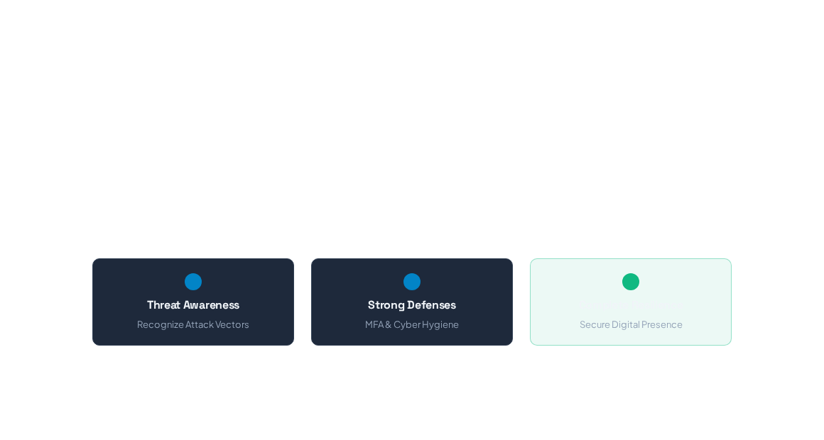
Cybersecurity & Cyber Fraud Defense
Understanding modern digital threats, defense frameworks, and practical strategies to remain safe from evolving online frauds.

Slide 2
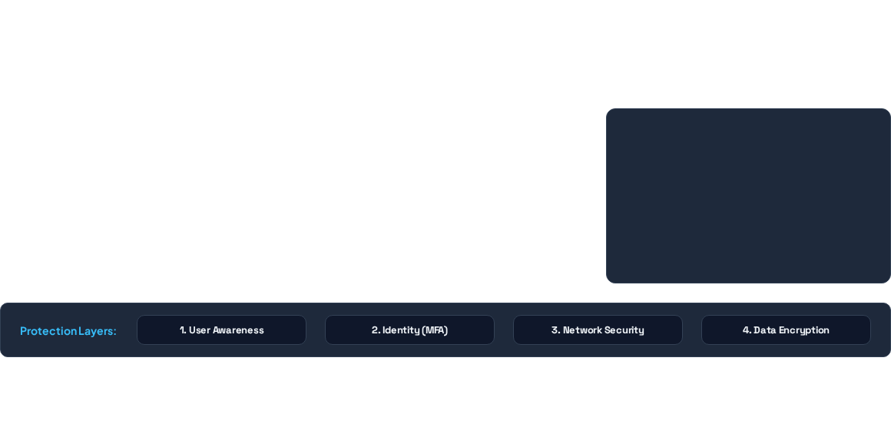






What is Cybersecurity?
Cybersecurity is the practice of protecting systems, networks, programs, and data from digital attacks, unauthorized access, or damage.
Confidentiality
Integrity
Availability
Ensuring sensitive data is accessible only to authorized users through encryption and identity controls.
Guaranteeing that information remains accurate, unaltered, and trustworthy throughout its lifecycle.
Maintaining reliable access to systems, networks, and data whenever authorized users require them.

Slide 3
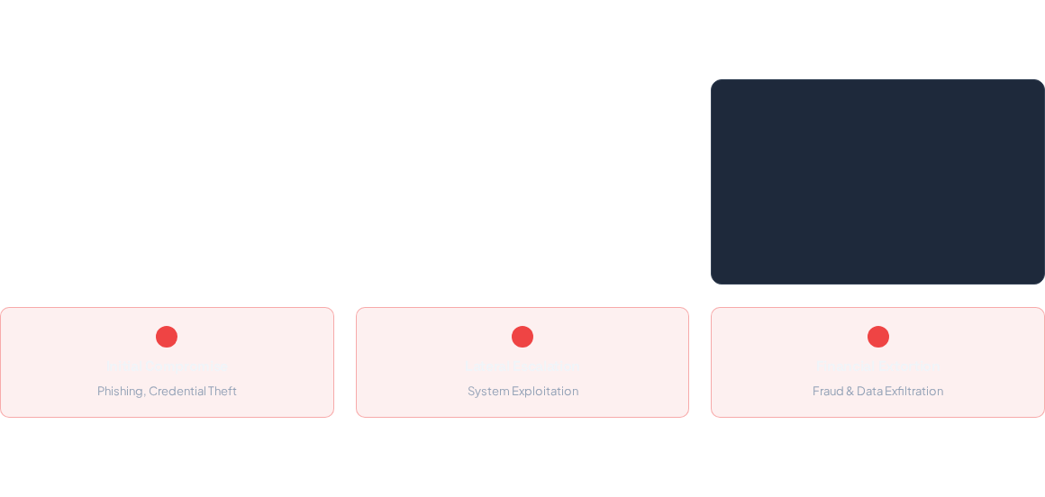





Modern Cyber Threat Landscape
AI-Driven Scams
Financial & UPI Frauds
Multi-Extortion Ransomware
Generative AI and deepfake audio/video mimic executives or relatives to bypass human trust and execute financial fraud.
Spoofed banking calls, fake QR codes, and malicious payment links target digital payment channels and mobile banking.
Attacks encrypt critical files and threaten public release of stolen personal data unless ransom demands are met.

Slide 4
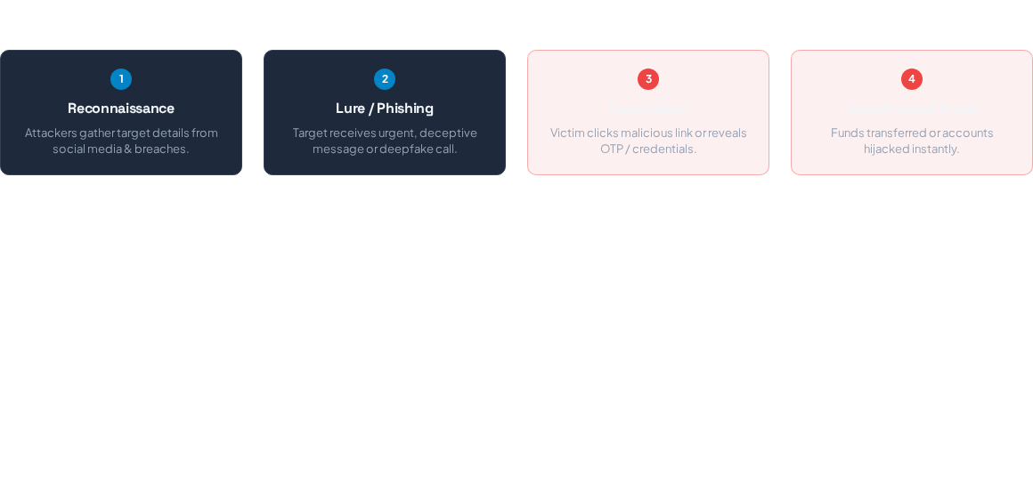

Modern Attack Lifecycle Flow
Cybercriminals follow a structured progression to execute scams. Interrupting any stage breaks the attack vector.
Defense Intervention Point
Pause before clicking or acting. Verifying requests through a trusted secondary channel breaks the chain between Step 2 and Step 3.

Slide 5
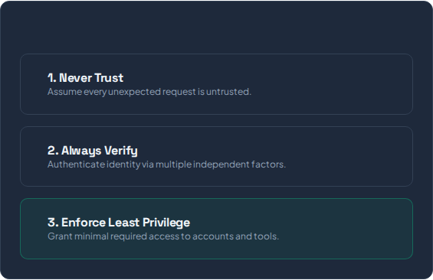
Essential Cyber Safety Rules
Zero Trust Safety Model
Adopt Passkeys & MFA: Move away from passwords to biometric passkeys and authenticator apps.
Verify Out-of-Band: Never trust caller IDs or emergency messages without direct verification.
Minimize Digital Footprint: Limit public personal details used for social engineering lures.
Patch & Update Promptly: Keep OS, apps, and security tools updated automatically.

Slide 6

Phishing Attacks & Prevention
Phishing remains the #1 initial entry point for cyber frauds worldwide. Let's analyze how it functions and how to defeat it.

Slide 7


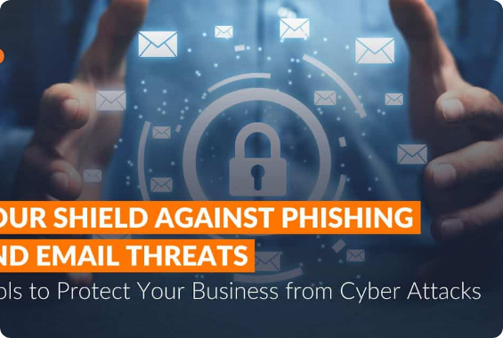
What is Phishing Fraud?
Phishing is a social engineering attack where bad actors deceive individuals into sharing sensitive credentials, financial details, or downloading malware.
Email Phishing
Spoofed emails disguising as legitimate institutions.
Smishing (SMS Phishing)
Text messages warning of urgent bank or package issues.
Vishing (Voice/AI Cloning)
Phone calls using synthetic voices to extract secrets.

Slide 8
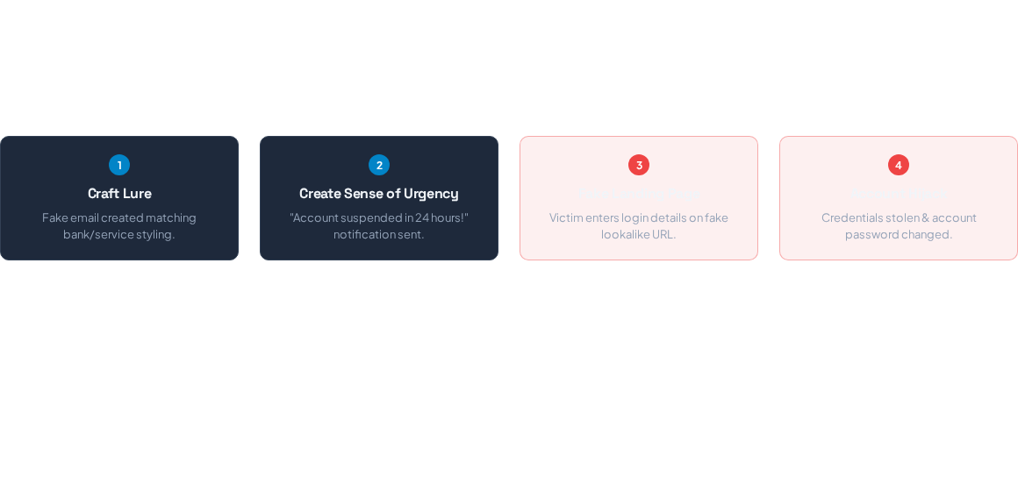


Anatomy of a Phishing Attack
Visualizing the step-by-step mechanism attackers use to execute a credential harvesting or financial scam.
Common Warning Indicators
Immediate Defense Action
Generic greetings, misspelled domain names (e.g. paypa1.com), artificial panic triggers, and requests for secret OTPs.
Never click direct links in unexpected emails. Open a browser and type the official URL manually.

Slide 9




Spotting & Preventing Phishing
Red Flag Signals
Preventative Measures
Urgent Threats: Claims of immediate account blockage or legal action.
FIDO2 Hardware Keys / Passkeys: Immune to phishing interception.
Mismatched Senders: Email address domain doesn't match the company name.
URL Verification: Hover over links to confirm destination domain.
Report Suspicious Activity: Flag phishing emails to security team immediately.
Unusual Attachments: Unexpected files (.zip, .exe, or passworded PDFs).

Slide 10
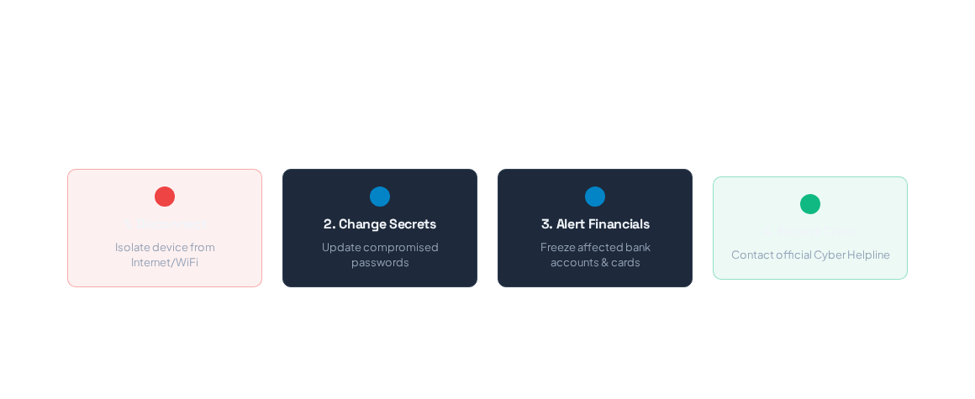

If You Suspect a Cyber Fraud...
Act quickly! Rapid response dramatically minimizes damage and stops fraud progression.
Cyber Helpline: 1930
National Portal: cybercrime.gov.in

Slide 11

Image Sources
https://itinsightsroc.com/wp-content/uploads/2024/01/2025-11-19-Blog-Cybersecurity-Part-2.jpg
Source: itinsightsroc.com

